Slide 1

Presented by – Dr.Suresh Ugle
NUTAN MAHAVIDYALAYA, SELU

Slide 2
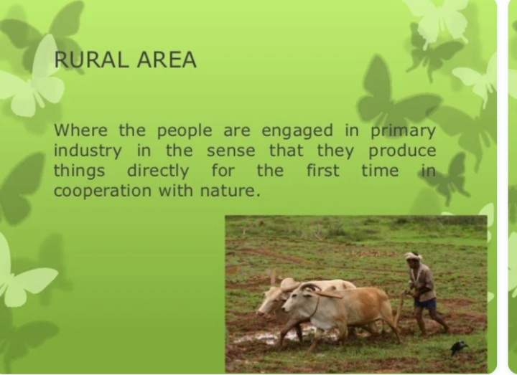

Slide 3
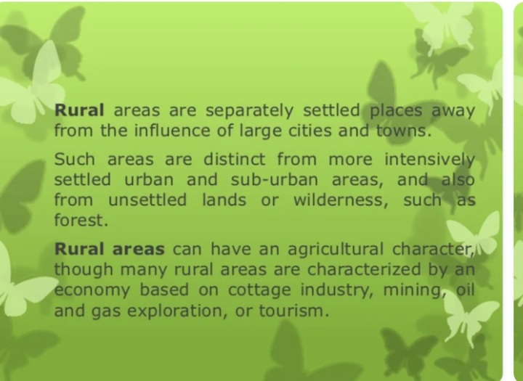

Slide 4


Slide 5
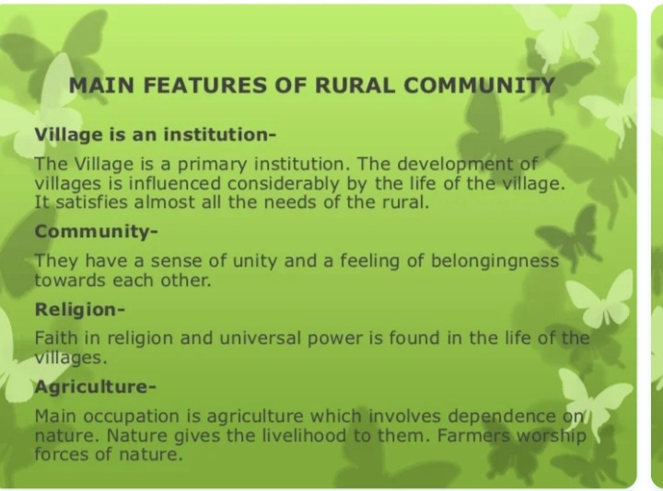

Slide 6
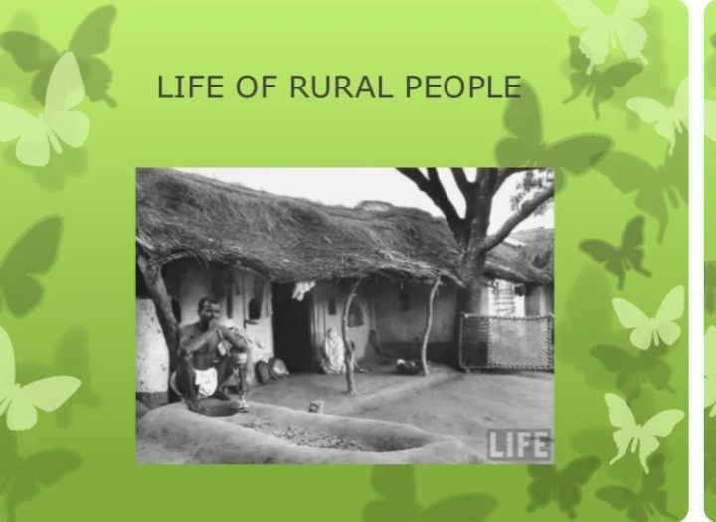

Slide 7
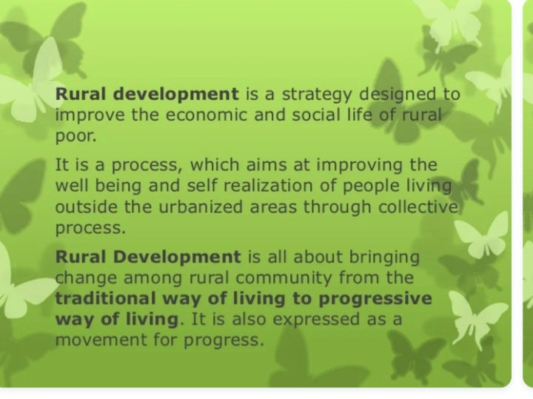

Slide 8


